Slide 1
MIS 407
W02c05
Prof. Smith

Slide 2
Recap
We cover the basics of initializing and managing staging and commits to a local repos.
For today, you should have read sections 2.1 through 2.5 of the ProGit online book
https://git-scm.com/book/en/v2

Slide 3
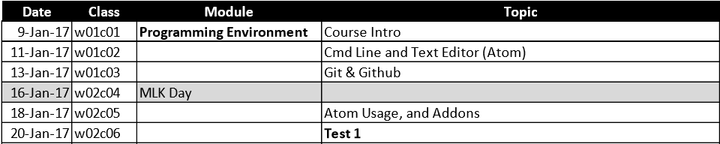
For Today…
Goals:
We will continue our discussion of Git, and compress our discussion on Atom (we will cover a bit more about Atom at the start of next class before our test).
No ICA for today. You’re welcomed to follow along with the commands I use, but it is not necessary.

Slide 4
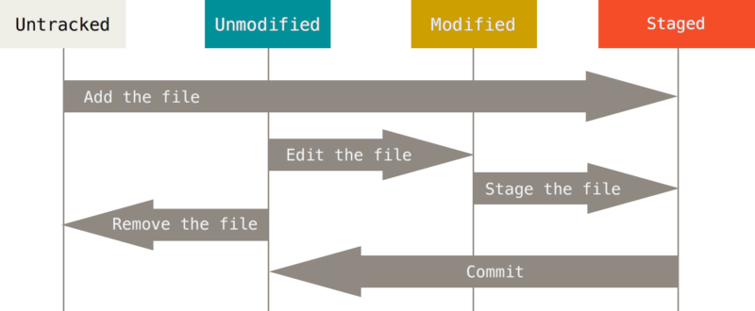
The four possible “states” of a of a file in your repo

Slide 5
Let’s switch to our class notes on GitHub…
Got to our GitHub site MIS407-17s
https://github.com/MIS407-17s
Look for the w0c05 folder in the Class-Notes repo.

Slide 6
For test 1 you should know how to…
Initialize a repo from a local directory, and from a clone from GitHub
Add and remove files for staging.
Commit files with messages.
Create a new Branch, switch between them
Merge branches, Delete Branches
Rollback a commit, amend a commit
Push and pull content to/from GitHub
Create MD (markdown) file using Atom
See class notes and sections 2.1 through 2.5 and sections 3.1 through 3.3
During Next class…
Spend a bit more time introducing Atom.
Test 1
It’s an open book test – you can use the internet to look things up, but cannot ask questions on the internet or share any content between classmates.

